Slide 1
What is a Cell?

Slide 2
In this lesson, we will be:
1. | Defining what a cell is.
2. | Stating the three points of the Cell Theory.
3. | Comparing the differences between unicellular and multicellular organisms.

Slide 3
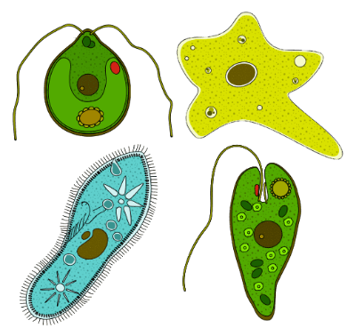
A cell is the basic building block, or the subunit of all living things.
There are about 100 trillion cells in the human body!
Some living things are only made up of one cell, like bacteria. They are called unicellular organisms.
Other living things can be made up of many cells, like us! They are called multicellular organisms.

Slide 4
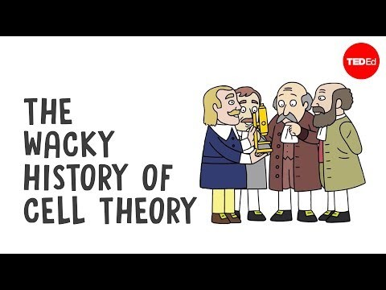

Slide 5
There are three main principles that determine what a cell is.
These principles make up the cell theory:
1. Cells make up all living things.
2. Cells are the basic building blocks of all living things.
3. All new cells are produced from existing cells.

Slide 6
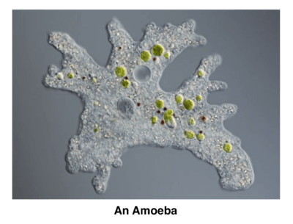
Unicellular organisms.
A unicellular organism is an organism made of only one cell. These organisms are very small and usually can only be seen with a microscope.
Some examples of unicellular organisms include: Amoeba, protozoa, unicellular algae, unicellular fungi, unicellular yeasts, paramecia and bacteria.

Slide 7
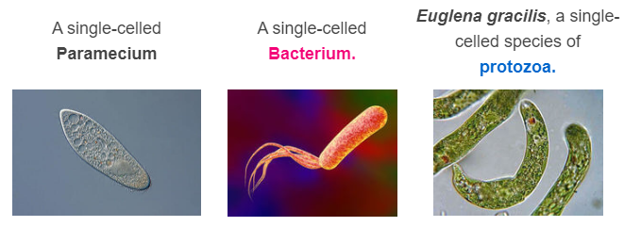
Here are some visual examples of unicellular organisms:

Slide 8

Multicellular organisms.
A multicellular organism is an organism made up of more than one cell.
Some examples of multicellular organisms include: humans, birds, fish, trees and spiders.

Slide 9

But why are we and some other organisms multicellular?
There are advantages to being multicellular rather than unicellular. These include allowing:
The organism to be larger.
Cell differentiation (having different types of cells with different functions).
The organism to be more complex.

